Slide 1
Angiosperms The Flowering Plants
Monocots Vs. Dicots

Slide 2
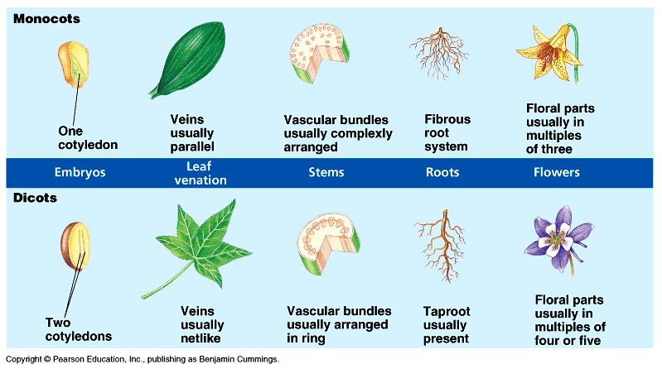
Main Differences

Slide 3
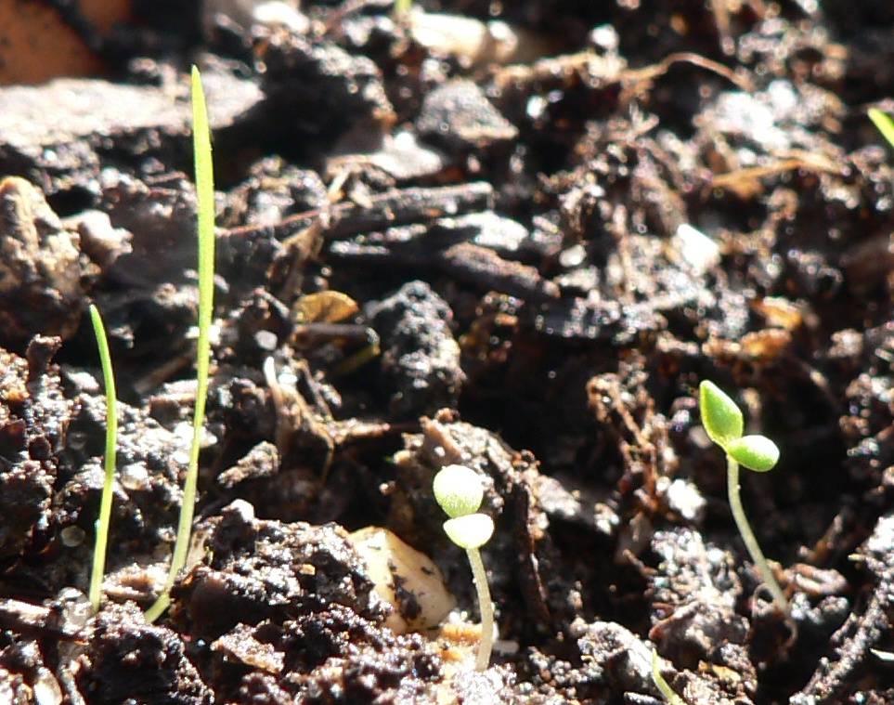
First Seed Leaves

Slide 4
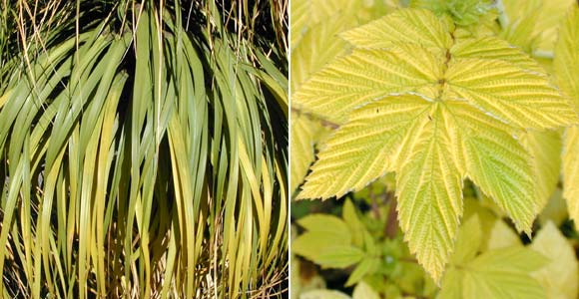
Leaf Differences - Vein Arrangement

Slide 5


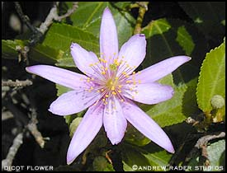
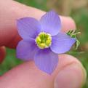
Monocots
Dicots

Slide 6
Examples
Monocots
Sedges
Grasses
Grains
Sweet potato
Corn
Lilies
Orchids
Onions
Palm trees
Dicots
Nut bearing plants
Roses
Beans
Cactus
Apple and Oak trees
Pumpkin
Tobacco
Grape vines
Poison ivy

Slide 7
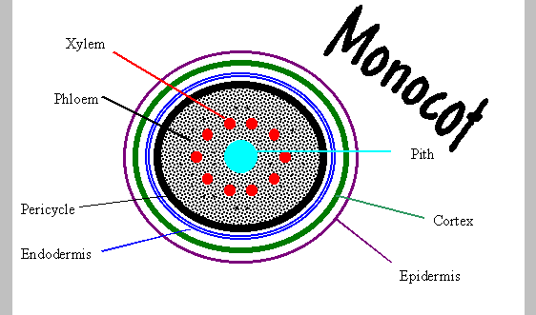
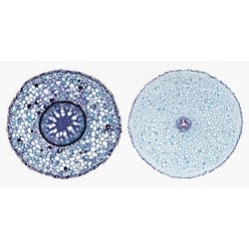
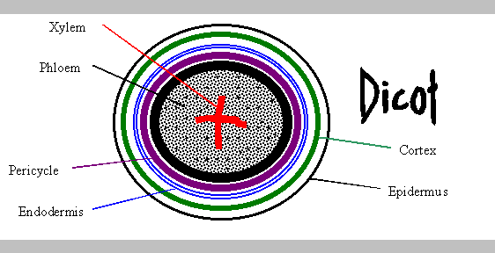
Root Differences

Slide 8
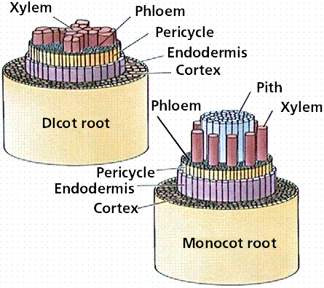
Root Differences – 3D!

Slide 9
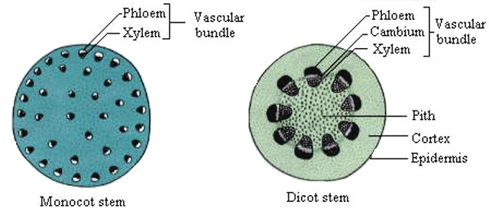
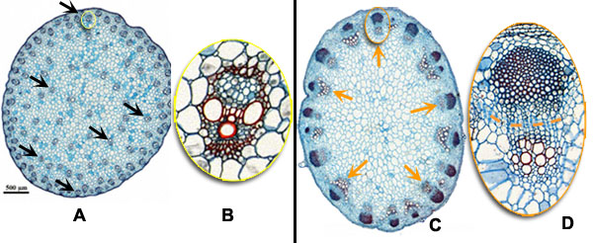
Stem Differences
Monocot Dicot

Slide 10

What do you think?

Slide 11
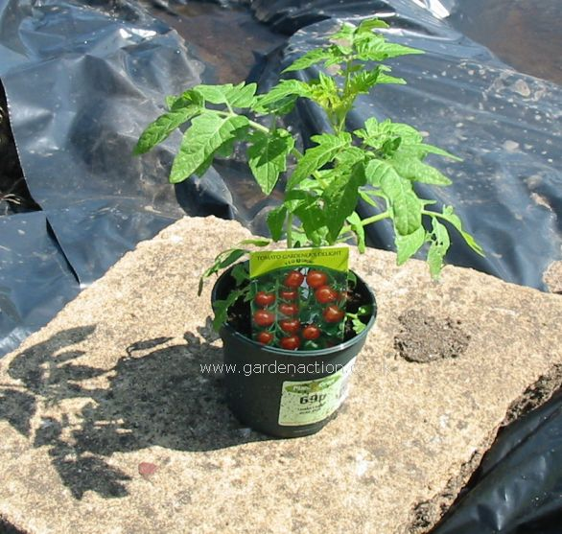
In case you’ve never seen a tomato plant….

Slide 12
....It’s a Dicot!! The End!!

